Slide 1
Planning Through Crisis Webinar Series
Going Virtual:
Strategies for Program Sustainability
HOSTED BY: Debra Thompson, President & Erika Berlin
info@getstrategy.com | www.getstrategy.com

Slide 2
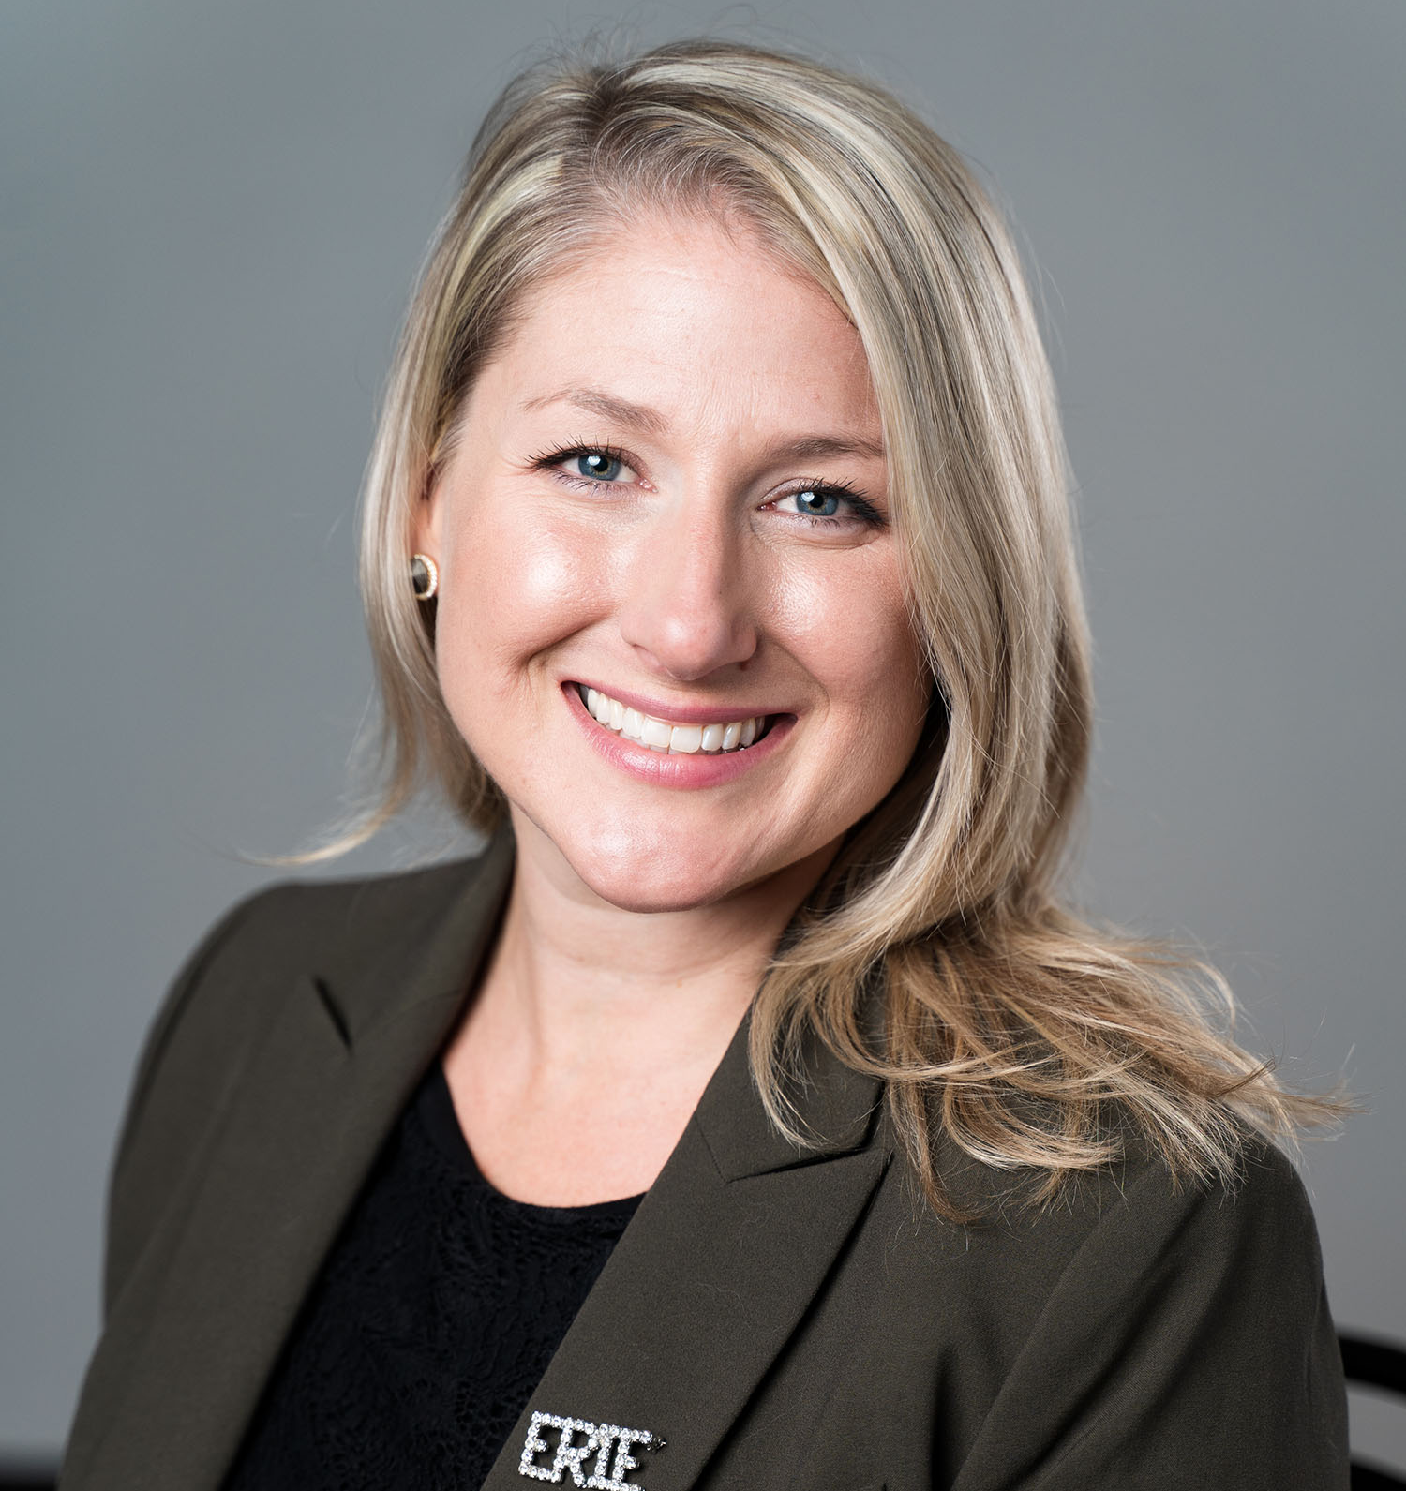
Going Virtual: Strategies for Program Sustainability
Going Virtual
Our Presenters
Debra Thompson, MBA
President & CEO
Erika Berlin
25+ years’ experience in strategic organizational development including research, planning, program development and evaluation.
Extensive experience in program development, program management and educational technology.

Slide 3
Going Virtual: Strategies for Program Sustainability
Understand how the current environment is impacting the nonprofit sector and how to identify opportunities despite current challenges
.
Learn how to challenge your assumptions and “think virtual” about your programs and services
A
B
Understand tools to develop and support virtual programming
Identify key next steps to develop a virtual plan for your programming
C
D
Objectives

Slide 4
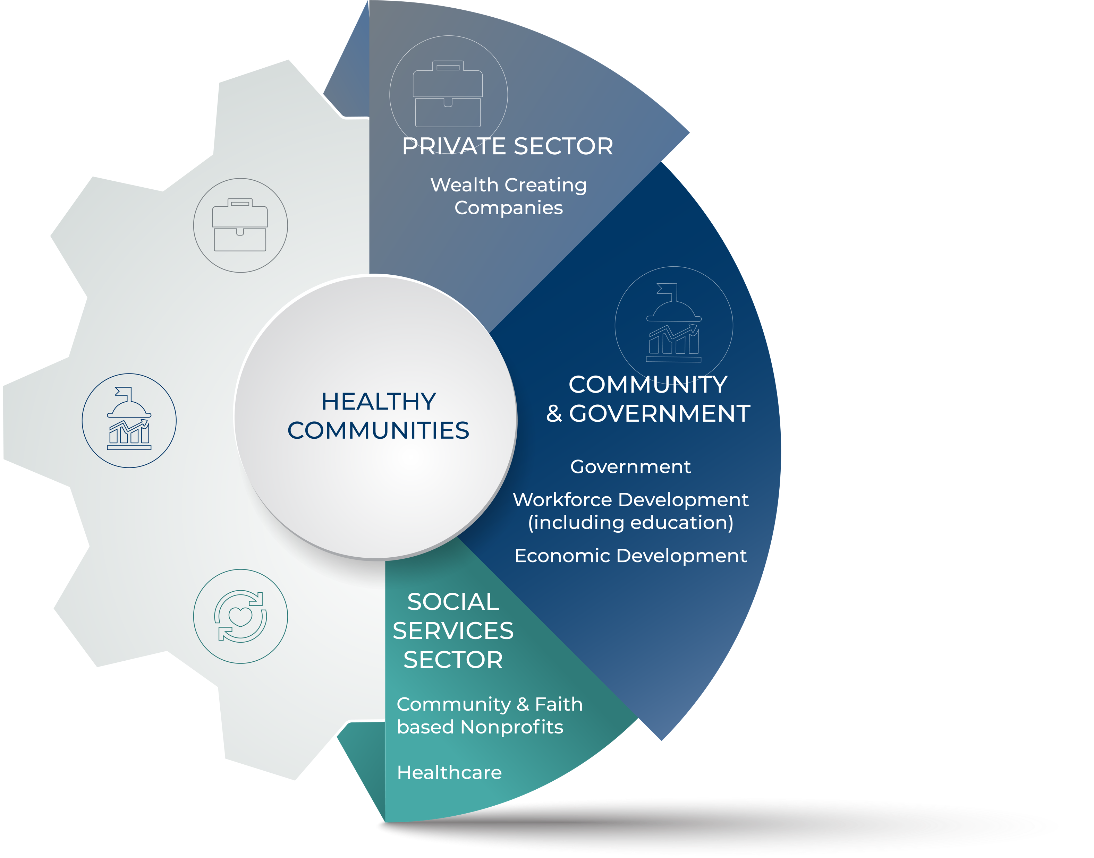
Going Virtual: Strategies for Program Sustainability
Creating healthier communities
Strategy Solutions works within and across sectors. Healthy communities are created when organizations are strong within each sector and are equipped to maximize the impact of their mission(s).
We work to support healthy organizations and strong sectors.
Our Approach
About Strategy Solutions

Slide 5
Going Virtual: Strategies for Program Sustainability
Our Reality:
The world has changed.
Amara’s Law:
We all have a tendency to overestimate the impact of phenomena in the short run and underestimate it in
the long run.
Robert Amara was an economist, futurist and former CEO of
Institute for the Future and was quoted by Ian Morrison, his successor in his book The Second Curve.

Slide 6
Planning Through Crisis
Nonprofits live on the edge, pouring everything they have into their mission.
Limited resources;
Increased demands on nonprofits, stemming from increased needs in communities; and
The growing awareness that every nonprofit and board member needs to be an active, vocal advocate for her/his nonprofit’s mission to affect policies in the community, and at a national level.
Source: National Council on Nonprofits
75%
of nonprofits said they would run out of cash in less than six months
19%
said they had only enough funds to last, at the most, for a month
Source: National Finance Fund
Nonprofit Trends

Slide 7
Going Virtual: Strategies for Program Sustainability
Nonprofit Networking Platforms
Earned Income
Private Sector Interaction
Greater Focus on Mission and Priorities
Artificial Intelligence
The Growing ‘Attention Economy’
Innovative Sustainability
Easier, More Personalized Giving
Nonprofits as Catalysts for Private-Public Partnership
Use of Cutting-Edge Technology
Donations Via Text
More Women of Color in Leadership Positions
2020 Nonprofit Trends

Slide 8
Going Virtual: Strategies for Program Sustainability
Truth
If you want your organization to be sustainable, you have to “rethink” how you deliver programs and services and be able to “go virtual” when necessary now and in the future.
INSANITY
Doing the same thing over and over, expecting different results

Slide 9
Going Virtual: Strategies for Program Sustainability
The world has changed.
PERSEVERENCE
In the very short run, it could be as easy as using “Zoom”
or some other web-based communications technology
Going Virtual

Slide 10
Going Virtual: Strategies for Program Sustainability
Over the long run, it’s a bit more complicated than that
Developing Virtual
Programming
Step 3
Utilize technology tools and resources to support virtual programming.
Step 2
Analyze the program work process flow and update for virtual delivery.
Step 1
Revisit your logic model, desired outcomes and impacts.

Slide 11
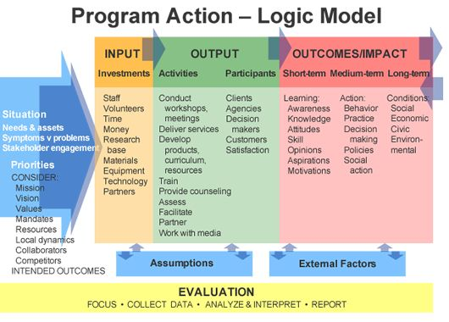
Going Virtual: Strategies for Program Sustainability
What is the long-term impact we seek to accomplish?
What are the intermediate outcomes we seek?
What are the short-term outcomes?
What activities are involved in the program to achieve outcomes and impact?
STEP ONE
Revisit Your Program Action Logic Model

Slide 12
Going Virtual: Strategies for Program Sustainability
The world has changed.
Stay focused on program outcomes
“Successfully use Zoom to have virtual meetings with clients”
IS NOT A PROGRAM OUTCOME
Inventory / brainstorm programs and ideas
What is possible? What has been sitting on the shelf?
Experiment with ”MVP” (Minimum Viable Product) or pilot
Start with free/low-cost tools; validate the program idea
GOAL
Virtual Program

Slide 13
Going Virtual: Strategies for Program Sustainability
Document activities and all process steps including the client experience
Determine how work process can be modified to be “virtual”
Determine policy barriers and/or approvals that need to be done to support process
Create a new work process flow
Train staff
Develop and roll out communications plan to clients
STEP TWO
Analyze Work Flow

Slide 14
Going Virtual: Strategies for Program Sustainability
Provide education or training
Lectures, employee skill development
Collect data
Opinion polls, crowdsourcing
Facilitate discussion groups
subject-specific groups, book clubs
Art exhibition or historical centers
Gallery opening, tour, watch party
Provide direct service
Coaching, health consultation
Program Goal/Delivery Method Examples

Slide 15
Going Virtual: Strategies for Program Sustainability
Consider…
IT Infrastructure and support
How do you provide tech support to your staff and clients?
Know your staff, know your clients
What software and hardware is needed?
Resist the urge to implement new or cutting-edge technology until you can validate audience capabilities
Materials: How do materials need to be revised for the tech environment? What is the backup? (tech will inevitably fail sometimes)
Establish expectations, allow norms to develop
Provide space for social connection
Be Practical

Slide 16
Going Virtual: Strategies for Program Sustainability
Tools and Techniques to support virtual programming
STEP THREE
Utilize Technology
There are a variety of different tools and techniques that can support virtual programming.
New philosophy and assumption: BIAS TOWARD ACTION – JUST DO IT!

Slide 17
Going Virtual: Strategies for Program Sustainability
Stay focused on your program goals and what best meets them! Big, expensive, or innovative does not necessarily mean a better virtual program!
Program success still depends on human leadership
DO THE RESEARCH
What best facilitates program goals?
What is simple? | What is ubiquitous?
What has exceptional customer support?
What can inform you about usage?
Choosing Technology
Leverage national org, partnerships, associations, memberships to use “big” or expensive technology

Slide 18
Going Virtual: Strategies for Program Sustainability
Provide education or training
Lectures, employee skill development
Tools: LMS, live-streaming
Collect data
Opinion polls, crowdsourcing
Tools: promoted surveys, Google forms polls, existing social networks
Facilitate discussion groups
subject-specific groups, book clubs
Tools: messaging apps, discussion forums, video/audio conferencing
Art exhibition or historical centers
Tools: virtual tours, interactive maps
Provide direct service
Coaching, health consultation
Tools: video, audio, text messaging apps
Simple Tech Solutions

Slide 19
Going Virtual: Strategies for Program Sustainability
Tool: Learning Management System
User Management
Multimedia Learning Content
Social
Personalization
Data & Analytics
Assessment
Automation
Consider your needs
Cloud or Open Source
Features
Internal or External
Compliance
Cost
Growth
Lessonly, Articulate, Adobe Captivate, Teachable, Canvas, Brightspace
Program
Education & Training

Slide 20
Going Virtual: Strategies for Program Sustainability
Bias toward action
Build empathy
Experiment
Be vigilant! (don’t set it and forget it)
The success of any virtual program is based on the people running it!
Build internal capacity
and seek help to navigate
the options
Conclusions

Slide 21
Going Virtual: Strategies for Program Sustainability
Thank you for your participation today.
If you feel that you would like some assistance, please don’t hesitate to reach out to us:
debbie@getstrategy.com
erika@getstrategy.com
WWW.GETSTRATEGY.COM
814.480.8000
Going Virtual: Strategies for Program Sustainability

Slide 22
Going Virtual: Strategies for Program Sustainability
We Are Here for You
Free 30 minute consultative support
Free webinars
jacqui@getstrategy.com | www.getstrategy.com

