Slide 1
Planning Through Crisis Webinar Series
Were Shut Down, Now What?
HOSTED BY: Jacqui Catrabone, MA
info@getstrategy.com | www.getstrategy.com

Slide 2
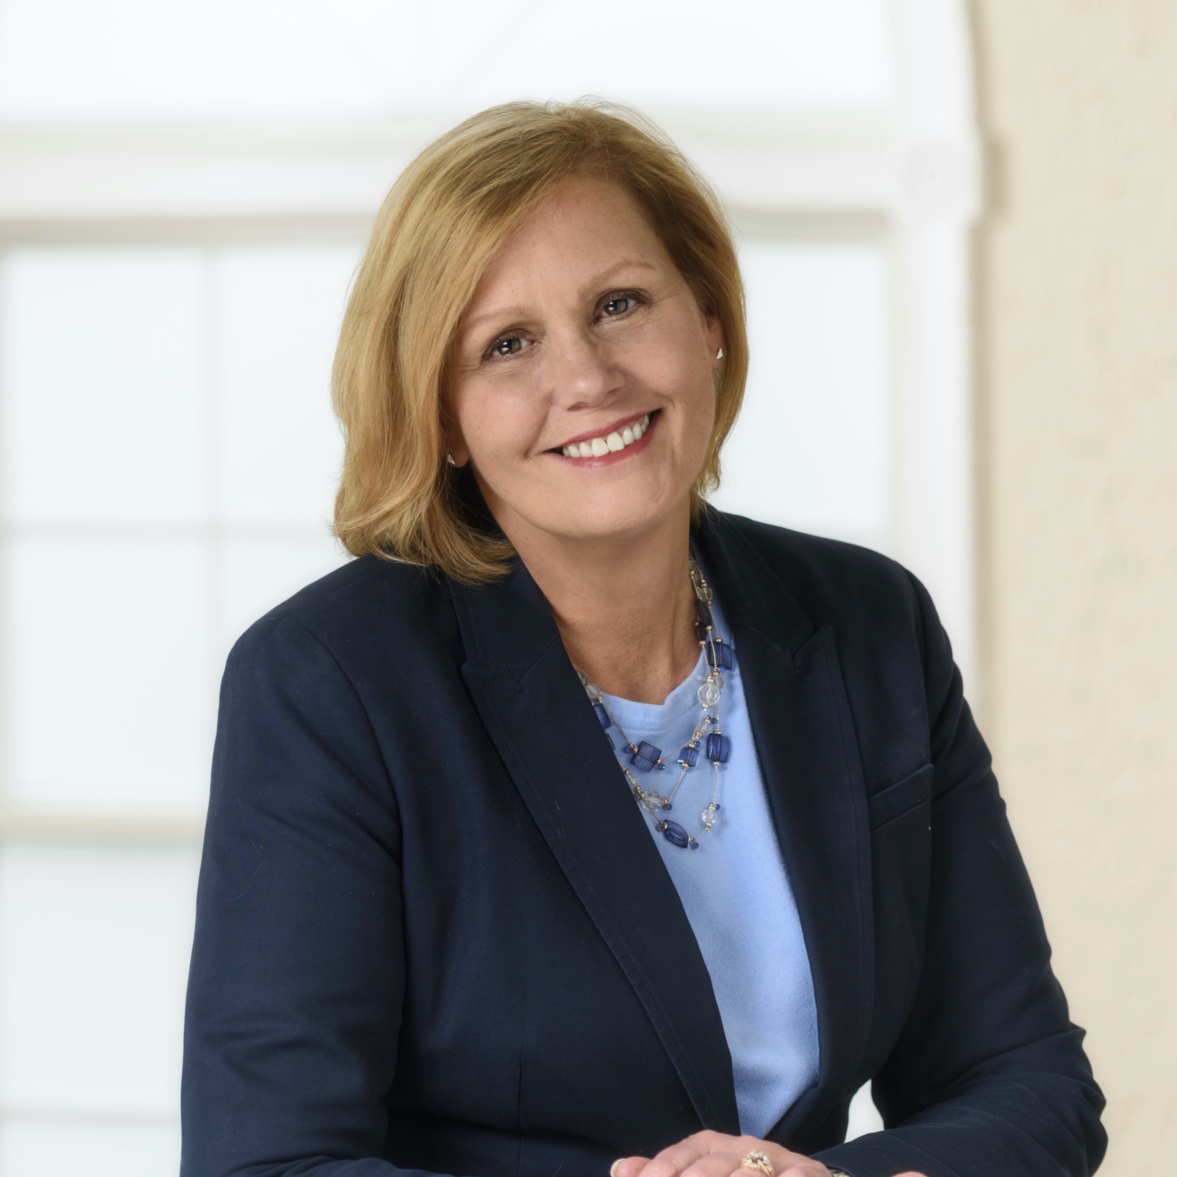
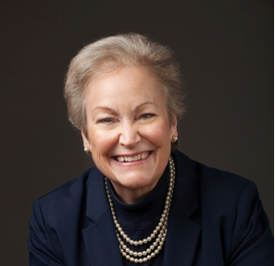
Planning Through Crisis Webinar Series
Our Series Presenters
Experienced
Leaders
Debra Thompson, MBA
President & CEO
Jacqui Catrabone, MA
Director, Nonprofit & Community Services
Margie Taylor, Certified Fund Raising Executive
25+ years’ experience in strategic organizational development including research, planning, program development and evaluation.
25+ years’ experience in healthcare and manufacturing operations as CEO, COO and HR Director.
Extensive experience in fundraising, economic development, public relations and communications

Slide 3
Planning Through Crisis
The world has changed.
I never dreamed we would be in a mandated shut down during my watch

Slide 4
Planning Through Crisis
The world has changed.
CONNECT
Be supportive
Be available
Be helpful
Seek input from others
Communicate, Communicate, Communicate

Slide 5
Planning Through Crisis
State the facts
It is okay to not have all the answers
Frequency
Relevant to audience
Clear and consistent
CONNECT
Communication
is Key

Slide 6
Planning Through Crisis
What about the media?
One spokesperson
Stay consistent
Ask to have an edit
COMMUNICATE

Slide 7
Planning Through Crisis
The world has changed.
PERSEVERENCE
I know we will recover;
but when and what will happen
in the meantime?
Be optimistic but realistic
Show concern for others
Instill confidence

Slide 8
Planning Through Crisis
Local, regional, national news
Trade associations
Member organizations
Elected officials
Philanthropic community
Regulatory agencies
KEY INFORMATION
Stay Informed

Slide 9
Planning Through Crisis
BEGINNING TO REGROUP
Finding ways to thrive
through a new strategic focus
Will those you serve be the same?
How will that impact your organization?
What resource implications will that have for your organization?

Slide 10
Planning Through Crisis
PRIORITIZE
GNO Analysis
Outside
Is this outside our authority? Make recommendations and/or advocate
Need Help
Can we solve this issue with assistance? Get it and take action!
Group
Is our group able to solve this issue ourselves? Do it!

Slide 11
Planning Through Crisis
Thank you for your participation today.
If you feel that you would like some assistance, please don’t hesitate to reach out to us:
jacqui@getstrategy.com
info@getstrategy.com
WWW.GETSTRATEGY.COM
814.480.8000
We’re Shut Down, Now What?

Slide 12
Planning Through Crisis
We Are Here for You
Free 30 minute consultative support
Free webinars
jacqui@getstrategy.com | www.getstrategy.com

