Slide 1
Planning Through Crisis Webinar Series
Hospital Community Health Leadership Post COVID-19: Capitalize on Positive Momentum Amidst Crisis
By Robert Gillio, MD, Chief Medical Officer, Force for Health
Debra Thompson, MBA, President, Strategy Solutions

Slide 2
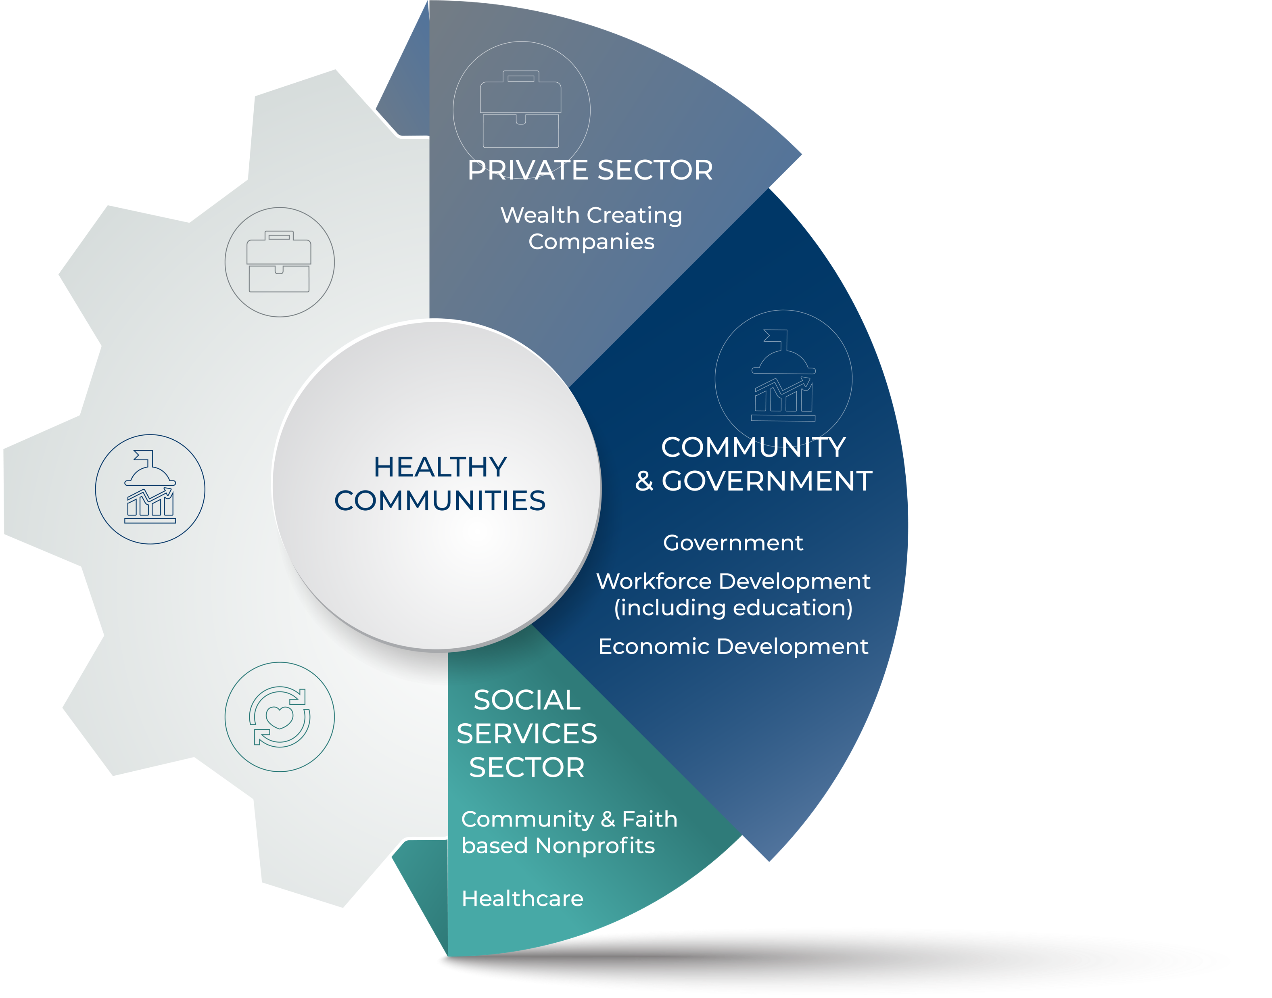
Finding Our New Normal: Updating Strategic and Operating Plans
Creating healthier communities
Strategy Solutions works within and across sectors. Healthy communities are created when organizations are strong within each sector and are equipped to maximize the impact of their mission(s).
We work to support healthy organizations and strong sectors.
Our Approach
About Strategy Solutions

Slide 3
Technology tools and resources to create a healthier community
Learning management system
Wellness and fitness goal setting
Interactive gaming
Tracking tools and resources

Slide 4
Planning Through Crisis Webinar Series
Our Team Includes
Experienced
Leaders
Debra Thompson
CEO and Founder
Robert Gillio, MD
25+ years’ experience in strategic organizational development including research, planning, program development and evaluation.

Slide 5
Capitalize on Positive Momentum Amidst Crisis
Understand how the current environment is impacting community needs and how to identify opportunities despite current challenges
.
Learn how to challenge your assumptions about sustainability and identify both short and long-term opportunities for revenue enhancement and community health improvement
A
B
Identify new tools and strategies to address community needs
Identify key next steps to help you update your CHNA Implementation strategies and plans
C
D
Objectives

Slide 6
Capitalize on Positive Momentum Amidst Crisis
Our Reality:
The world has changed.
Amara’s Law:
We all have a tendency to overestimate the impact of phenomena in the short run and underestimate it in
the long run.
Robert O'Mara was an economist, futurist and former CEO of
Institute for the Future and was quoted by Ian Morrison, his successor in his book The Second Curve.

Slide 7
Capitalize on Positive Momentum Amidst Crisis
Push to deliver home based care will continue
The balance of power will shift from hospital systems back to physician groups
Drug pricing will be a front page issue; pharmaceutical innovation will dominate headlines
“Medicare for All” will morph into “Medicare Advantage for All”
Big tech and Silicon Valley will continue to play but they won’t upend the system
Big box retailers will continue to enter the market
Companies that are transparent and ethical will come out ahead
Expect more talk than action around social determinants of health
Mental health and substance use disorders will take main stage
The public will begin to examine the behaviors of “nonprofit” health systems
Fax machines will see their bitter end
2020 PRE-PANDEMIC
Healthcare Trends
Source: Forbes

Slide 8
Capitalize on Positive Momentum Amidst Crisis
Covid-19 has created “social distancing” and isolation
There is “no going back” to business as usual
While numerous emergency funds are being established, many community hospitals (especially rural) don’t have the resources to be sustainable
There are about 2,000 rural hospitals in the United States, and two-thirds of them have 25 or fewer inpatient beds available,
More than half these rural hospitals operate in the red on an annual basis
Since 2010, 128 rural hospitals have closed, eight in 2020 alone; at least three have closed since the pandemic began."
The lockdowns required to keep COVID-19 from overwhelming the U.S. health care system also unfortunately robbed these rural hospitals of a key source of income.
Source: US News & World Report
Our New Reality

Slide 9
Capitalize on Positive Momentum Amidst Crisis
Truth
If you want your organization to be sustainable, you have to “rethink” your product/service/market positioning, production and delivery, your CHNA implementation strategy and maybe even your entire business model
INSANITY
Doing the same thing over and over, expecting different results

Slide 10
Capitalize on Positive Momentum Amidst Crisis
Hospital Community Health Leadership Post-Covid 19
Step 3
Develop new implementation strategies that address long term community needs as well as help manage through crisis
Step 2
Identify strategies that improve community health AND generate revenue
Step 1
Ask and answer the “right key strategic questions”

Slide 11
Capitalize on Positive Momentum Amidst Crisis
How do community hospitals survive financially given the devastating financial losses to serve another day?
How can hospitals address the social determinants of health in a manner that achieves a return on investment?
How do we address the poverty pandemic and the undertreatment pandemic in our communities as well as the disease pandemic that caused them?
How do we deal with infectious disease as a chronic condition?
How can communities leverage health literacy to prevent further pandemics and mobilize resources if necessary, in the in the event of future disasters?
Ask and Answer The “Right Key Strategic Questions”

Slide 12
Capitalize on Positive Momentum Amidst Crisis
Invest in remote monitoring
New Medicare rules now provide reimbursement for remote monitoring
HIPAA regulations have been relaxed
Apply for federal grants
(FCC, USDA and HRSA) provide resources to support telemedicine.
Deploy a portion your furloughed clinical staff to monitor patients with chronic diseases
Achieve a return on investment
Offers opportunity to refer patients for needed treatments or emergency intervention
Identify Strategies That Generate Revenue AND Address Community Health Needs

Slide 13
Capitalize on Positive Momentum Amidst Crisis
Create a “Medical Reserve Corps”
Identify and train staff that can be deployed in an emergency
Send staff to other areas of the country that are willing to pay a premium for medical professionals
This is a strategy that could keep people employed but also generate some marginal revenue for the hospital
Identify Strategies That Generate Revenue AND Address Community Health Needs

Slide 14
Capitalize on Positive Momentum Amidst Crisis
Act as a platform for gathering information, engaging citizens and tracking individual and program data
Organize potential donations, such as creating a virtual stockpile of food, medical or protective equipment
Establish a team of health literate volunteers and/or community health workers can promote healthy lifestyles and save valuable time in an emergency situation
Create a community resource that can disseminate information and engage individuals to mobilize for action
Offer educational tools through a virtual learning management system that individuals can access on their smart phones
Augment your wellness activities health education with the Force for Health GO app for images and locations to trigger healthier choices, resources, learning or behaviors throughout the community using QR codes
Invest In an IT Portal To Organize Regional Assets and Coordinate Interventions

Slide 15
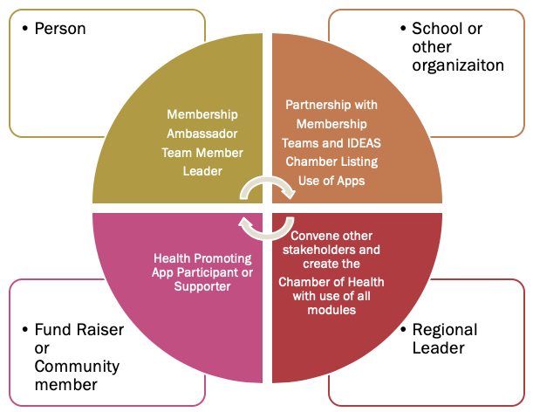
Capitalize on Positive Momentum Amidst Crisis
Act as a platform for gathering information, engaging citizens and tracking individual and program data
Text
Invest In an IT Portal To Organize Regional Assets and Coordinate Interventions

Slide 16
Capitalize on Positive Momentum Amidst Crisis
Organize potential donations, such as creating a virtual stockpile of food, medical or protective equipment
Text
Invest In an IT Portal To Organize Regional Assets and Coordinate Interventions

Slide 17
Capitalize on Positive Momentum Amidst Crisis
Establish a team of health literate volunteers and/or community health workers can promote healthy lifestyles and save valuable time in an emergency situation
Text
Invest In an IT Portal To Organize Regional Assets and Coordinate Interventions

Slide 18
Capitalize on Positive Momentum Amidst Crisis
Create a community resource that can disseminate information and engage individuals to mobilize for action
Text
Invest In an IT Portal To Organize Regional Assets and Coordinate Interventions

Slide 19
Capitalize on Positive Momentum Amidst Crisis
Offer educational tools through a virtual learning management system that individuals can access on their smart phones
Text
Invest In an IT Portal To Organize Regional Assets and Coordinate Interventions

Slide 20
Capitalize on Positive Momentum Amidst Crisis
Augment your wellness activities health education with the Force for Health GO app for images and locations to trigger healthier choices, resources, learning, or behaviors throughout the community using QR codes
Text
Invest In an IT Portal To Organize Regional Assets and Coordinate Interventions

Slide 21
Modules for each of the levels of the validated socio-ecologic model
The person has been shown to thrive if all aspects of the community are part of the solution. The community prospers when are members share their skills and actions to advance the community.

Slide 22
MODULAR TOOLS HELP AT ALL LEVELS
www.theforceforhealth.com
MEMBER PORTAL
WITH BASIC AND ADVANCED TOOLS INCLUDING HEALTH RISK ASSESSMENT, VIRTUAL WELLNESS CLUB, AND TELEHEALTH RESOURCES
ACADEMY
WITH ONLINE AND DEVICE COURSES, CHALLENGES, QUIZZES, INCENTIVE, BADGES, POINTS AND AUTHORING CAPABILITIES
ENGAGEMENT APPS
AUGMENTED AND VIRTUAL REALITY
VIRTUAL HEALTHETHONS
ACTIVITY BASED GAMES AND CHALLENGES
CHAMBER OF HEALTH PORTAL
COMMUNITY DIRECTORY, CALENDAR, AND MEDIA TOOLS, WITH HEALTHY FUND RAISING OPPORTUNITIES.
DATA, INSIGHTS, AND ANALYTICS
TRACK EVERYTHING, TO HELP ADVANCE POLICIES, CONTENT AND PRACTICES

Slide 23
Capitalize on Positive Momentum Amidst Crisis
The success of any organization is based on the ability to adapt to the needs of a changing environment!
Identify strategies that generate revenue and address community health needs
Remote monitoring
Medical reserve corps
Invest in an IT portal to organize regional assets and coordinate interventions
Conclusions

Slide 24
Capitalize on Positive Momentum Amidst Crisis
Thank you for your participation today.
If you feel that you would like some assistance, please don’t hesitate to reach out to us:
debbie@getstrategy.com
drrob@theforceforhealth.com
WWW.GETSTRATEGY.COM
814.480.8000
Hospital Community Health Leadership Post COVID-19: Capitalize on Positive Momentum Amidst Crisis

Slide 25
Planning Through Crisis Webinar Series
Please Join Us On…
WWW.GETSTRATEGY.COM
814.480.8000

Slide 26
Planning Through Crisis Webinar Series
We Are Here for You
Free 30 minute consultative support
Free webinars
jacqui@getstrategy.com | www.getstrategy.com

